Slide 1

Topic: Rates and Energy
EQ: How do we work out rate conversions and apply it to heart rates?

Slide 2
Topic: Rates and Energy
EQ: How do we work out rate conversions and apply it to heart rates?
What is a rate?
A rate shows how one quantity changes with another quantity.
We write a rate using the / symbol or the word per
Price of petrol is cents per litre or c/L
Heartbeat is beats per minutes or beats/min
A rate compares 2 quantities measured in different units

Slide 3
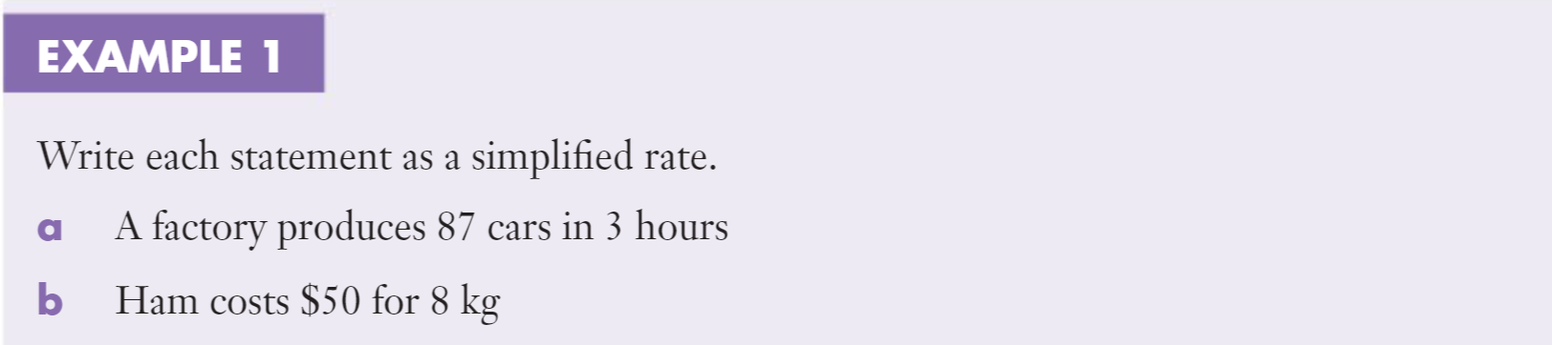

Slide 4
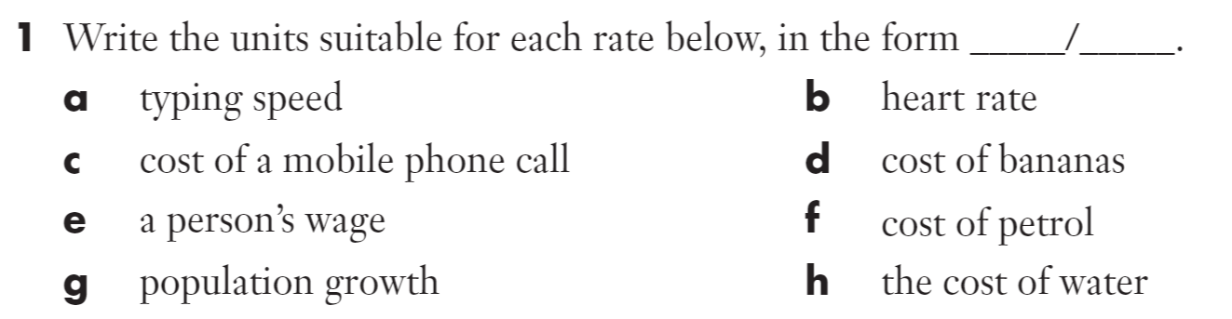
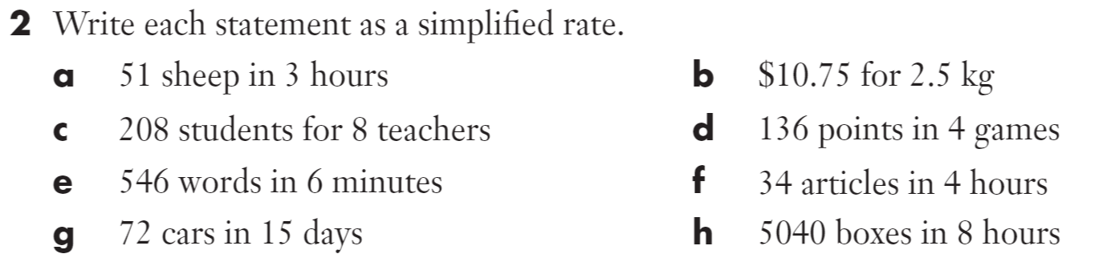

Slide 5
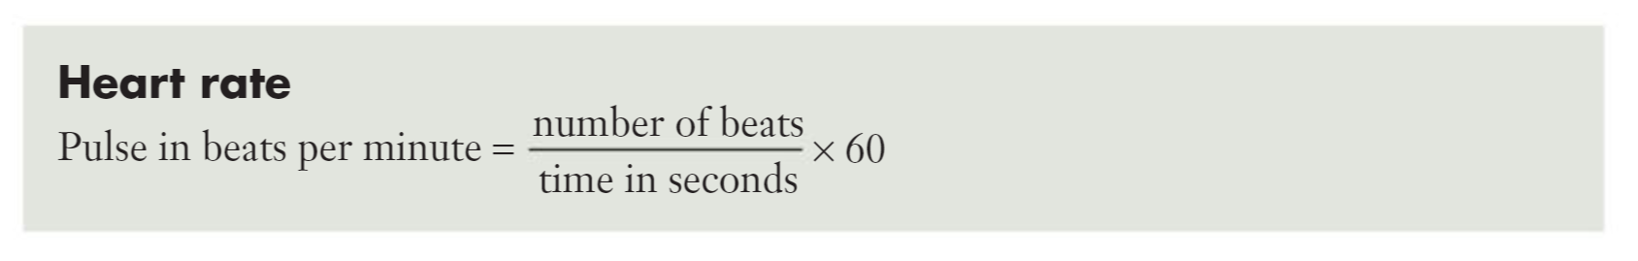
Topic: Rates and Energy
EQ: How do we work out rate conversions and apply it to heart rates?
What is heart rate?
The heart is a muscle that pumps blood around our body. We all have a resting heart rate. During exercise or times of stress our heart rate increases. After exercise the time it takes for our heart to return to its resting rate is a measure of out fitness.
We measure heart rate or pulse in beats per minutes.

Slide 6
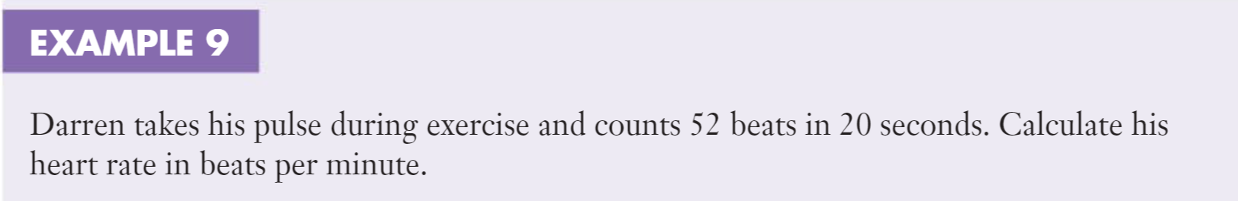

Slide 7
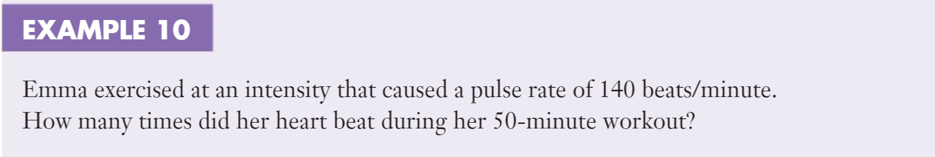

Slide 8
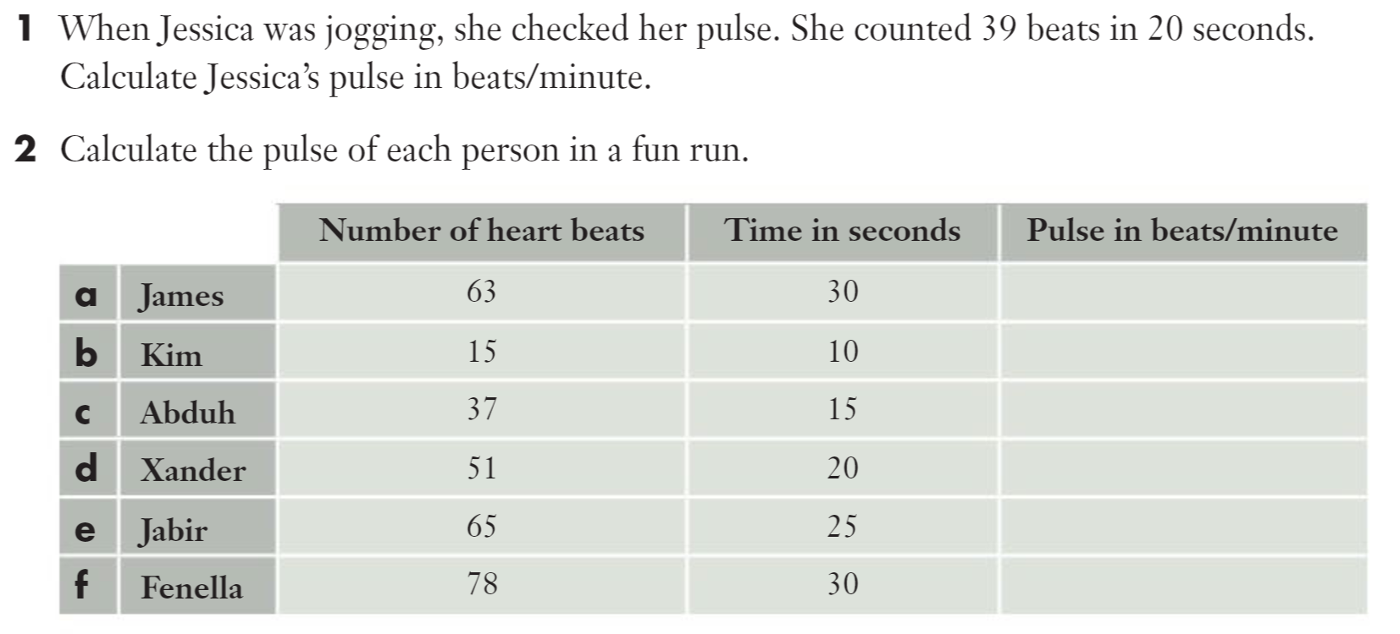

Slide 9
